Slide 1
Interrupts
Interrupts = Unexpected Function Call
Hardware generated by external signal
Examples: Timer done, A/D done, EX0
Also known as:
  Exception
  Trap
See text p288-295, databook 2.17-33
Notes:
Interrupts or specifically I/O interrupts, sometimes called imprecise interrupts are an unexpected, hardware generated subroutine call in response to some signal external to the CPU. Some example signals include status bits such as the A/D done bit, Timer done bit, and external interupt bit Ex0. Interrupts are sometimes called exceptions or traps. Larger processors respond to interrupts from various error conditions such as arithmetic overflow, divide by zero, illegal memory references, illegal instructions, power low, etc. Don’t confuse interrupts which are hardware generated with so-called ‘software interrupts’ which are really just a form of programmer initiated function calls. These are frequently used to implement operating system calls.
Interrupts are more fully explained in the text [1] on page 288-295, in the 8051 family hardware reference manual [2] on page 2-33 and in the 8051 family architecture manual [3] on page 2-17. Reference [4] Chapter 6 is devoted to interrupts on the 8051.
[1] Tom Schultz, C and the 8051 Hardware, Modular Programming, and Multitasking, 2cnd ed, Prentice Hall,1998.
[2] Philips 1997 cdrom databook. Famhdwr.pdf
[3] Philips 1997 cdrom databook. Famarch.pdf
[4] I. Scott MacKenzie, The 8051 Microcontroller, 3rd ed, Prentice Hall, 1999.

Slide 2
Interrupt Sequencing
An interrupting event actually occurs
  Can happen at any time
  Independent of internal processor operation
  Sometimes called an imprecise interrupt
The interrupt event is detected by the processor
  Only occurs at discrete sample times (S5P2)
The interrupt(s) is (are) polled and highest priority one selected for service.
Notes:
To understand what goes on during an interrupt, it is helpful to think about the rising edge detector program we saw earlier. A rising edge (event) can occur at any time, dictated by external events such as your finger pressing a button, a signal generator switching, a sensor triggering, etc. The signal is sampled at discrete intervals by the processor. A rising edge event is detected as having occurred when the signal is low in one sample and high in the next. The maximum delay in event detection occurs when the event happens just after a sample time. We call this delay ‘latency’. Multiple events could occur during this sampling period and only one can be serviced. The time required to sort this out is the polling interval. Since interrupts are allowed to occur in between instructions the polling interval is the last cycle of an instruction.

Slide 3
Basic instruction execution
N
Instruction Fetch
12 to 48 clocks on 8051
Decode
Execute
Notes:
Recall that instruction execution proceeds by 1) fetching the instruction from memory, 2) decoding the instruction and fetching any operands, and 3) executing the instruction and writing any results to memory. On the 8051 this takes from one to four instruction cycles where each cycle lasts 12 clock cycles.
Although some high performance mainframe machines allow interrupts to occur during an instruction, that is rare and expensive to implement. It’s much more common to only allow interrupts to occur in between instructions.
On the 8051 this means that it can take from one to four cycles to start processing an interrupt after it is detected.

Slide 4
Add interrupt polling
Y
Interrupt?
Call
N
Instruction Fetch
Save PC
Decode
New PC
Execute
Mask Interrupt
Notes:
Interrupts can occur at any time. They are only acknowleged in between instructions. When one instruction has finished execution and before a new instruction in fetched, the control unit checks to see if an interrupt is pending. If so then the control unit effectively forces a call instruction to be executed to call the interrupt service routine. The PC is saved, a new PC is loaded with an address dependent upon the interrupt being serviced and further interrupts, at least from the current source, are prohibited otherwise an infinite loop would occur!

Slide 5
Hardware Generated Call
Some considerations:
  Where to save the PC?
  Where does the call’s address field come from?
  What about the rest of the processor’s state?
PC is pushed on the stack
The address depends on the interrupt
  This address is called an interrupt vector
Registers can be saved by switching banks
Notes:
Some architectural issues in designing a new computer include where to save the PC in case of interrupts. If a stack is used to save return addresses for function calls then that mechanism is also used for interrupts.
Since the CALL isn’t an instruction in memory in the case of interrupts, we need a mechanism for generating an address. This could be a fixed location in which case the software must undergo a polling procedure to determine what caused the interrupt or it could be a location determined by the interrupt source, or it could be a mixture of the two. The latter mechanism is called vectored interrupts. A group of events such as the 8051’s UART transmit and receive done events could share a single interrupt vector.
In normal function calls, the compiler can arrange to save registers in memory. Since interrupt generated CALL’s can occur anywhere in the program, it is up to the interrupt procedure to save any registers it uses and restore them upon return. This is true of ANY register such as storage locations, the ACC, carry flag, etc. The 8051 makes it easy to save registers by implementing four banks of registers. A new bank can be selected by simply changing bits in the PSW.

Slide 6
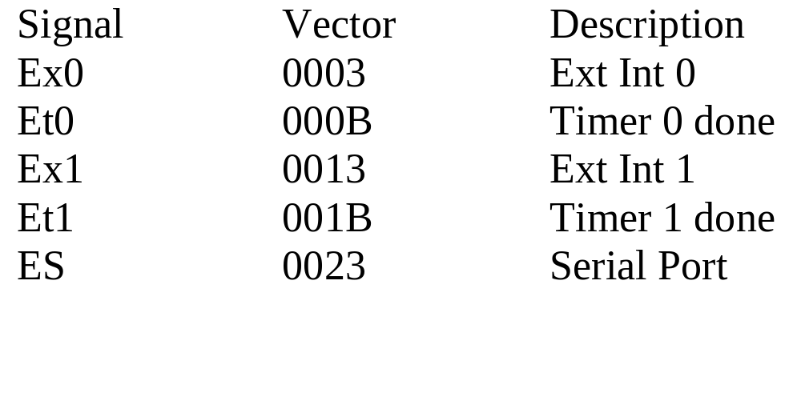
Interrupt Vectors
Standard 8051 interrupt sources
Serial port is really two sources in one: Tx done and Rx done
Notes:
Here are the interrupt vectors for the 8051. Ex0 and Ex1 are dual functions that share P3 bits. They are called Int0 and Int1.

Slide 7
Interrupt Priority
Two points of view:
  What to do in case of ties? (priority)
  Who can interrupt whom? (interrupt levels)
Ties must be broken by hardware priority
Multiple interrupt levels can be implemented by either hardware or software
Notes:
The term interrupt priority is used in two different contexts. Two interrupting events can have two different priorities relative to each other. Call the two I1 and I2. If I1 and I2 both occur at the same time (during the same sample interval), only one can be serviced first so there must be a tie breaker mechanism to determine which one gets serviced first. Lets assume that I1 is higher priority than I2. While I1 is being serviced, other interrupts of the same priority level are masked off and must wait until I1 service is finished before being serviced in turn. Higher priority interrupts could interrupt I1’s service routine. It’s entirely possible for I1 to be serviced first but be lower in priority than I2! The 8051 has a fixed priority tie breaking mechanism and a two level priority interrupt structure.

Slide 8
Tie breaker
Essentially a priority encoder
Interrupt sources in, interrupt vector out
Ex0
Et0
Ex1
Interrupt Vector
Et1
ES
Notes:
The tie breaker mechanism is essentially a priority encoder.

Slide 9
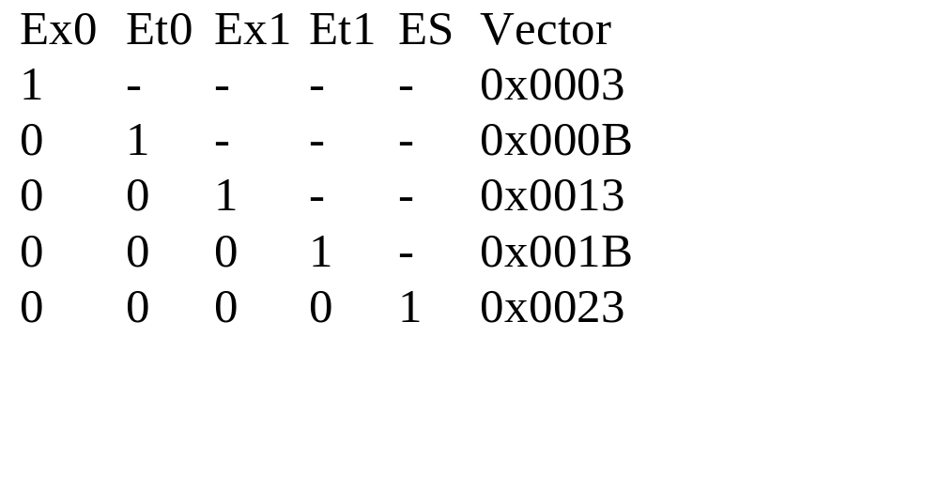
Priority Encoder
Notes:
If requests of the same priority level are received simultaneously, an internal polling sequence determines which request is serviced. External interrupt 0 is the highest priority, ES (Rx+Tx) is lowest.
ES is the UART status interrupt.
Etn is the timer interrupt. There are two of these.
Exn is the external interrupt pin. There are two of these. They can be selected to be either level sensitive or edge sensitive.

Slide 10
Interrupt Priority
Who can interrupt whom is determined by interrupt level
8051 supports two levels of interrupt
A high priority interrupt can interrupt a low priority interrupt service routine
Default is all low priority so only one interrupt at a time
Notes:
See the 80c51 family hardware description document for more details

Slide 11
Interrupt Priority Example
EX0 - low priority, EX1 - high priority
Both EX0 and EX1 occur at same time
Result:
  Tie breaker selects Ex0 and vectors to C:0003
  Second interrupt from EX1 occurs
  EX1 service routine finishes.
  EX0 service routine finishes.
Notes:
In this example, Int1 has been programmed to be a high priority interrupt. If both Int0 and Int1 occur at the same time, Int0 is serviced first. One instruction from the Int0 service routine will be executed, then the Int1 higher priority interrupt will be acknowledged and serviced.

Slide 12
Interrupt operation
time
Main()
Interrupt
EX0 ISR
RETI
EX1 ISR
Notes:
Here is a timing diagram for the example. The interrupt service routines terminate with a return from interrupt (RETI) instruction and return to the interrupted program. A RETI always allows at least one instruction to execute so that progress is always made in the interrupted program even if interrupts are occurring at a high rate.

Slide 13
Return from ISR
ISR - Interrupt Service Routine
A normal RET can’t be used!
  Interrupts would stay disabled
RETI re-enables interrupts at that level and returns to interrupted program
How does C51 know to use RETI?
  Void Ex0ISR(void) interrupt 0{}
Notes:
C51 knows that a function is an interrupt service routine from use of the keyword interrupt in the function declaration. The number following indicates the vector which will be used to enter this function. In this example, vector 0 at location C:0003 is used. On the 8051 this is assigned to Int0.

Slide 14
Special Function Registers
7
IE Register
0
EA
ES
ET1
EX1
ET0
EX0
EA= 1; //enables interrupts
EA=1; EX0=1; //enable interrupts from EX0 only
IE= 0x87; //enable interrupts from EX0, ET0, and EX1
Interrupts MUST be turned on to work. Default is off
Notes:
The interrupt system is controlled by at least two special function registers: the interrupt enable (IE) register and the interrupt priority (IP) reg. Individual interrupts must be enabled and a global enable (EA) must be set in order for interrupts to be acknowledged. The SFRs are both bit addressable.

Slide 15
Interrupt Priority Register
7
IP Register
0
PS
PT1
PX1
PT0
PX0
IP= 0x13; //Serial port, Timer 0, and External interrupt 0 are high priority, others are low
PT1=1; //make Timer 1 high priority level
Default is all low priority, all same level
Enable high priority source to interrupt low priority source
8051 only has two levels of interrupt priority: high+low
Notes:
By default, all interrupts are level 0 (low) priority. Individual bits may be made level 1 (high) priority by setting bits of the IP register.

Slide 16
Context Switching
8051 has four register banks:
  D:0-7 bank 0
  D:8-F bank 1
  D:10-17 bank 2
  D:18-1F bank 3
PSW= PSW | 0x10; //use reg bank 2
7
PSW Register
0
RS1
RS0
Notes:
Bits 3 and 4 select the register bank in use. In C the compiler takes care of this but care must be used so that you don’t call a function which uses bank x from a program which uses bank y! This holds true for library functions as well. The main source of trouble would be in cases where the compiler must use the actual storage location of a register. This varies depending on the bank in use.

Slide 17
Interrupt Example
static int counter;
void Ex0Isr(void) interrupt 0 using 1{
counter++; }
void main(void) {
IT0= 1; //enable neg edge triggered int0
EX0= 1; //enable external interrupt 0
EA= 1; //enable global interrupts
while(1) P1= 5*P2;
}
Notes:
Here is a simple example involving just external interrupt 0. We wish to increment a counter every time a falling edge occurs at Int0 (P3.2). I’ve included a while loop to give the processor something to do while waiting for edges to occur. This is a typical situation with a foreground operation taking place (5*p2) while a background operation is (apparently) going on at the same time (incrementing a falling edge counter).
In order to do this simple task without interrupts we would have to include a test for a falling edge inside the while loop thus wasting a lot of time when there is no edge to count. In this case we are letting the hardware detect the falling edge and call a function to increment the counter when such events occur.

Slide 18
Ex0 Interrupt Service Routine
static int counter;
void Ex0Isr(void) interrupt 0 using 1{
counter++; }
Declare counter global so both ISR and Main can ‘see’ it.
Interrupt 0 makes this Ex0’s ISR
  Ex0 interrupts vector to location C:0003
using 1 causes code to use Register Bank 1
  Context switches to bank 1
Notes:
Why is Ex0ISR declared void with no parameters passed into or out of the function?
(ans: Ex0ISR isn’t called in the usual sense. Values are passed in and out through the use of shared global variables.)
What would happen if main() occasionally needed to increment or decrement counter?
(ans: you’d need to be careful since an interrupt could occur in between reading counter and writing it thus wreaking havoc.)

Slide 19
Ex0 ISR in 8051 ASM
0000 C0E0 PUSH ACC
0002 0500 R INC counter+01H
0004 E500 R MOV A,counter+01H
0006 7002 JNZ ?C0005
0008 0500 R INC counter
000A D0E0 ?C0005: POP ACC
000C 32 RETI
Note how ACC is saved and restored
RETI re-enables interrupts
Notes:
What would happen if the accumulator wasn’t saved in the ISR? Recall that in other functions we’ve written, the ACC isn’t saved and restored.
This function uses no registers other than the ACC so the USING clause doesn’t do much. If the example was larger so that registers were used then code would be generated to switch to bank 1 upon entry and back to the previous bank upon return.

Slide 20
Interrupt Initialization Code
IT0= 1; //enable neg edge triggered int0
EX0= 1; //enable external interrupt 0
EA= 1; //enable global interrupts
IT0 is bit 0 of Timer Control Reg (TCON)
EX0 and EA are bits in Interrupt Enable Register (IE)
Code is executed once to configure and enable interrupts
Notes:
Be sure to enable BOTH the global enable bit as well as any individual enable bits for interrupts which you expect to service. This doesn’t actually cause any events to occur, it just permits them to interrupt the processor.

Slide 21
Main Program
0006 E5A0 ?C0002: MOV A,P2
0008 75F005 MOV B,#05H
000B A4 MUL AB
000C F590 MOV P1,A
000E 80F6 SJMP ?C0002
This program gets interrupted by falling edges on Int0 (P3.2)
Interrupts can occur at any time but are acknowledged only between instructions
Notes:
What would be the worse possible time for an interrupt to occur in this example? (near the start of MUL since it’s four cycles long)
Consider the task of crossing US63. You need to wait for breaks in the traffic. If traffic occurs in bursts of one to several cars, the worst time for you to try crossing the street is right at the beginning of a long line of traffic.

Slide 22
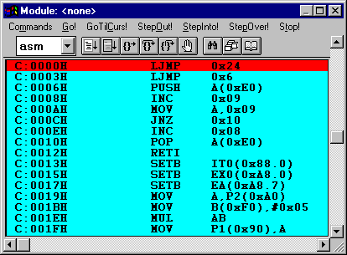
Behind the scenes
Startup vector
Ex0 vector
Ex0ISR
Notes:
Here’s what the example looks like inside dScope. Notice the LJMP at location 3. This is the vector for Int0. The LJMP is the first instruction of the
Ex0ISR function. In this case it wasn’t needed but normally we would be using several vectors and there is at most 8 bytes in between each. That’s not much room for an ISR.

Slide 23
Interrupt Timing
Interrupts sampled during S5P2
Interrupts polled during last cycle of instruction
PC pushed onto stack (2 cycles)
Fetch first instruction of ISR
A RETI or access to IE or IP lets one more instruction execute before pushing PC
Notes:
Now we want to consider interrupt timing in more detail. The basic sequence is: 1) sample during the last quarter of each cycle, 2) poll interrupts during the last cycle of an instruction and break ties, 3) push the PC onto the stack in two cycles, and 4) fetch the first opcode of the ISR. If the last cycle of an instruction occurs during a RETI or other instruction which accesses IE or IP (changes the interrupt system state) then one more instruction is allowed to execute before pushing the PC.

Slide 24
Interrupt Timing
1 cycle (12 us)
S1
S2
S3
S4
S5
S6
Interrupts sampled here
S5P1
S5P2
S6P1
S6P2
0.25 us
Notes:
Interrupts are sampled at S5P2 clock cycle which is 0.25 uS before the end of each cycle.

Slide 25
Interrupt Timing
MUL
Cycle 1
Cycle 2
Cycle 3
Cycle 4
PC low
PC high
2
3
4
1
1. Int0 falling edge occurs
2. Ex0 interrupt detected
3. Interrupts polled. Start Ex0ISR
4. Push PC on stack (LCALL 3)
Interrupts Sampled
Notes:
Here an event occurs between cycle 1 and 2 of a MUL. The event is detected 0.25 uS before the end of cycle 2. It is polled during the last cycle (3), and two more cycles are taken to push the PC onto the stack. 4.25 to 5.25 uS elapse before we begin to fetch the first instruction of the ISR (usually a LJMP). This delay is called interrupt latency. In systems which must react quickly to external events (called real time systems) this is an important figure of merit. Microsoft Windows is widely belittled in embedded systems circles for having non-deterministic interrupt latency or response time. This is due to the fact that Windows keeps interrupts off for long periods of time and it can take arbitrarily long for an interrupt to be acknowledged.

Slide 26
Worst Case Interrupt Timing
Instr
RETI
MUL AB
Save PC
9.25 uS
1. Level 1 event occurs just after sample in second to last cycle of instruction.
2. Interrupt sampled in last cycle of Instr
3. Interrupt polled in last cycle of RETI
4. RETI allows one more instruction: 4 cycle MUL
5. Plus two cycles to save PC
6. Equals 9.25 uS worst case (or is it really?)
Notes:
This is the worst case scenario if there are two levels of interrupt and only one level 1 interrupt. If there are two level 1 interrupts, then the second level one interrupt may have to wait arbitrarily long for the first level 1 interrupt service routine to finish. Another example would be a single level 0 interrupt which occurs while EA=0, interrupts turned off.

